Slide 1
Using Technology for Interactive STEM Applications
Lucie Mingla
Department of Mathematics
New York City College of Technology, CUNY
Metro NExT

Slide 2
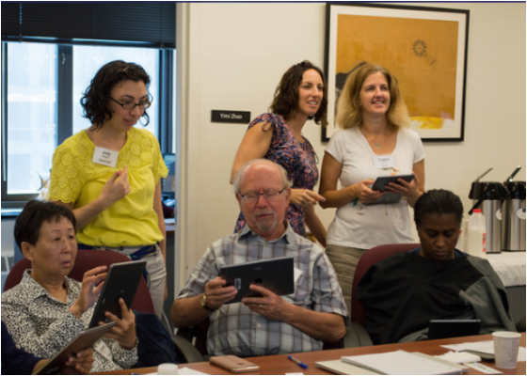
OG Interactive Seminars
Active Learning Strategies
OER-s
Games in the classroom
Flipped classroom(Videos)
Introduction to WeBWork
Using Desmos and OpenLab for interactive activities and enrichment

Slide 5
https://screencast-o-matic.com/account

Slide 6
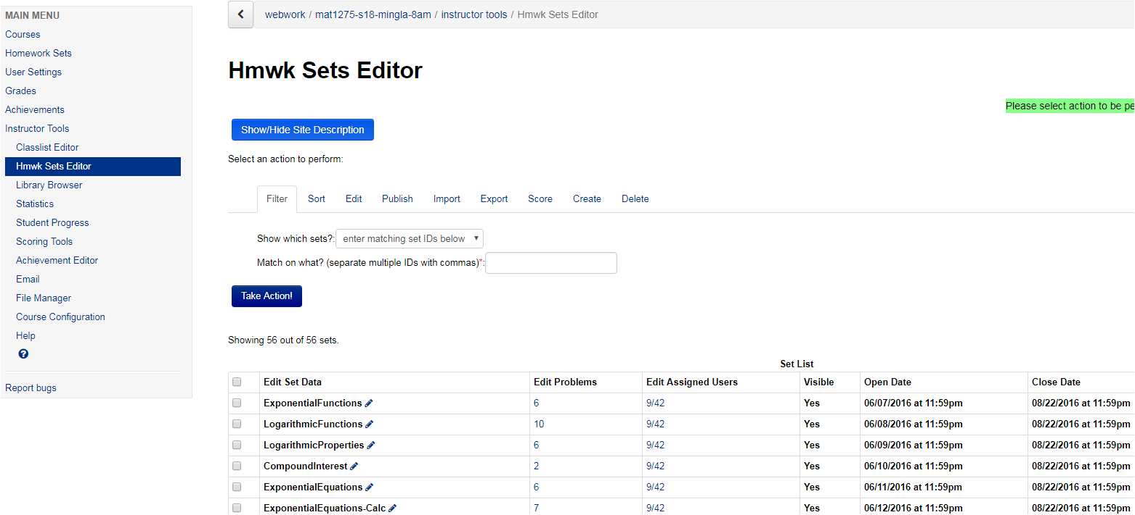

Slide 7
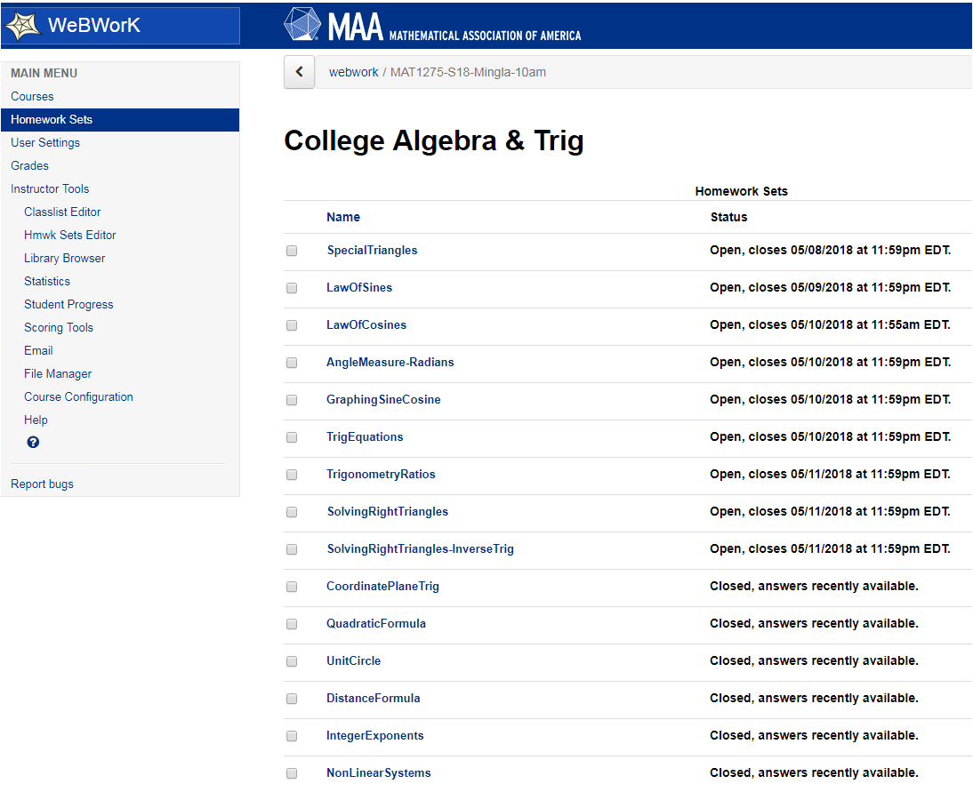

Slide 8
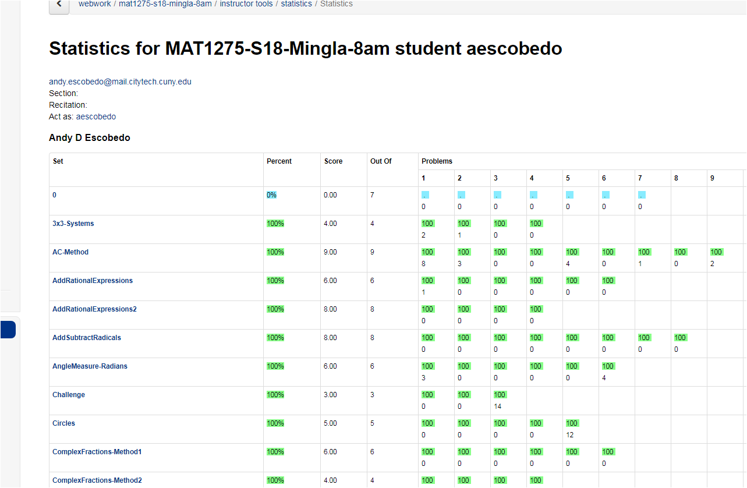

Slide 9
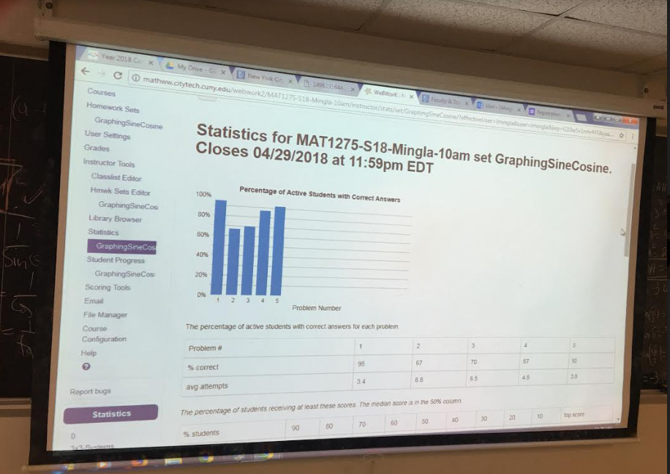
Feedback on Real Time

Slide 10
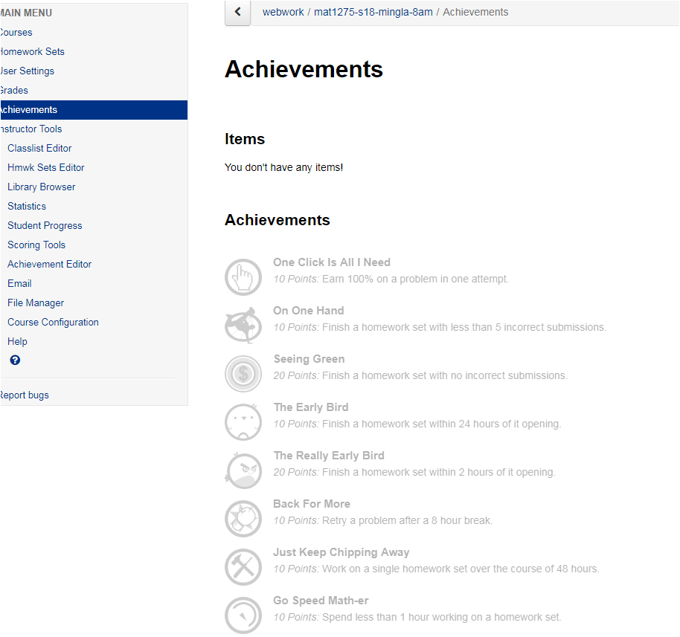
Games in WeBWork

Slide 11
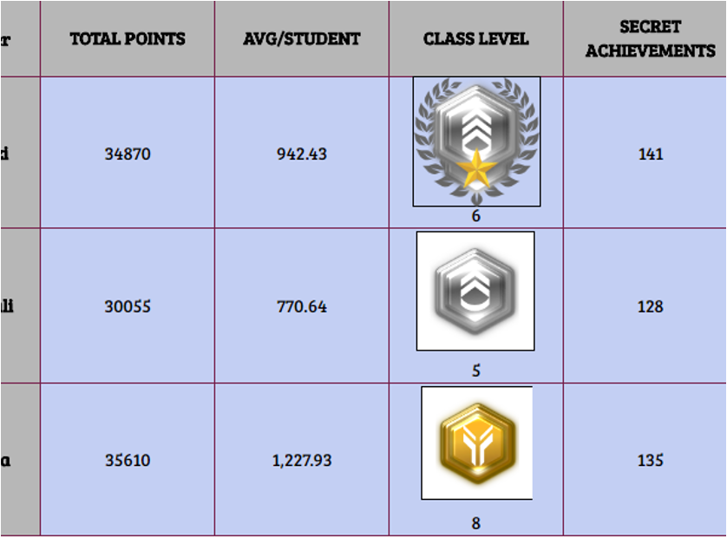
Class Achievements

Slide 12
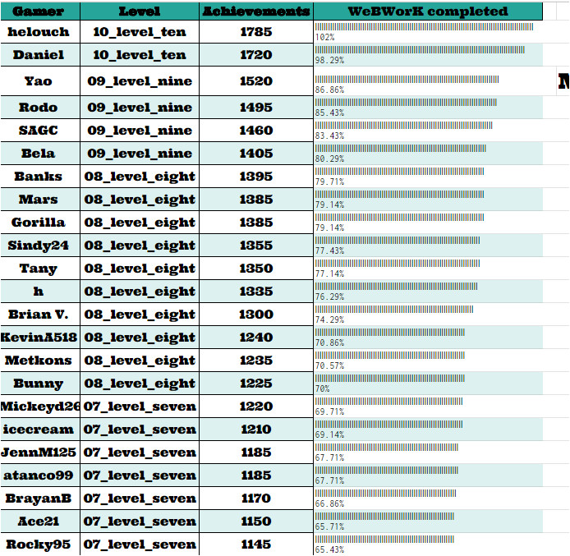
Individual Achievements

Slide 13
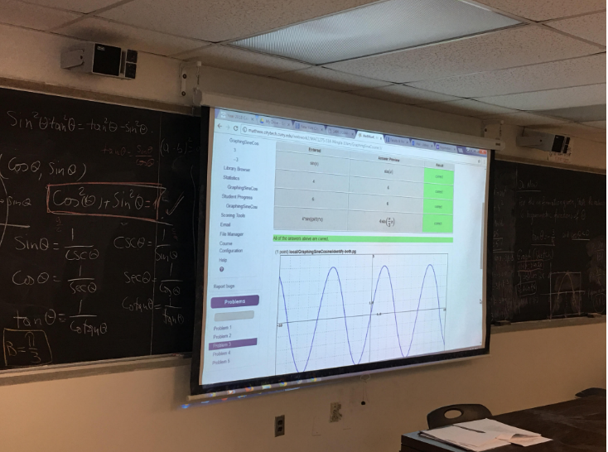
Guiding in Class, Using I pod-s or tablets

Slide 14
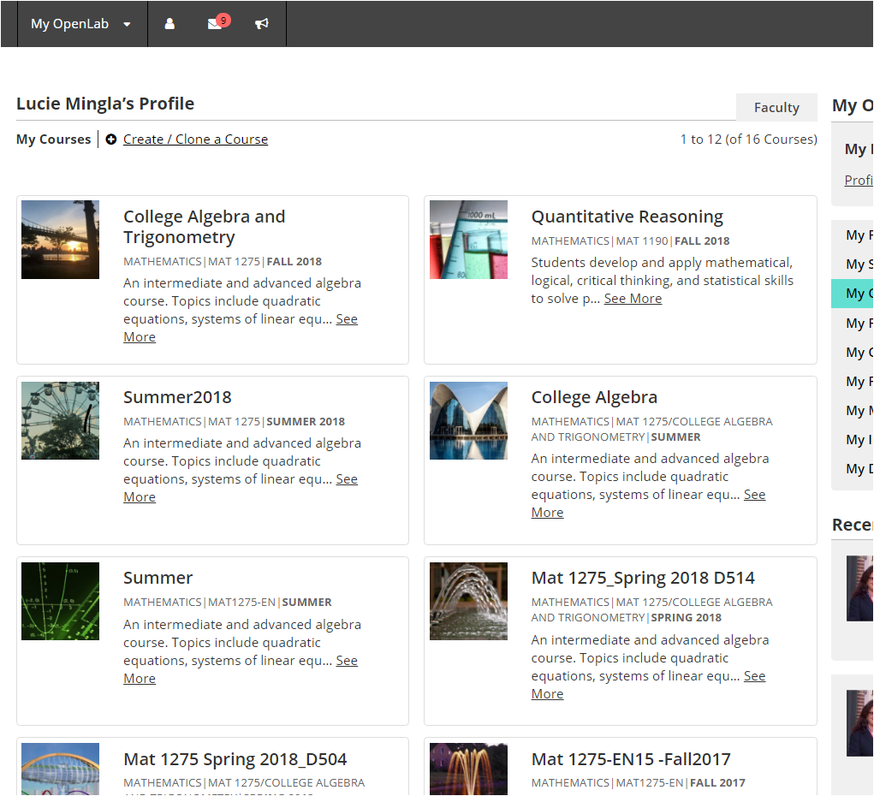

Slide 15
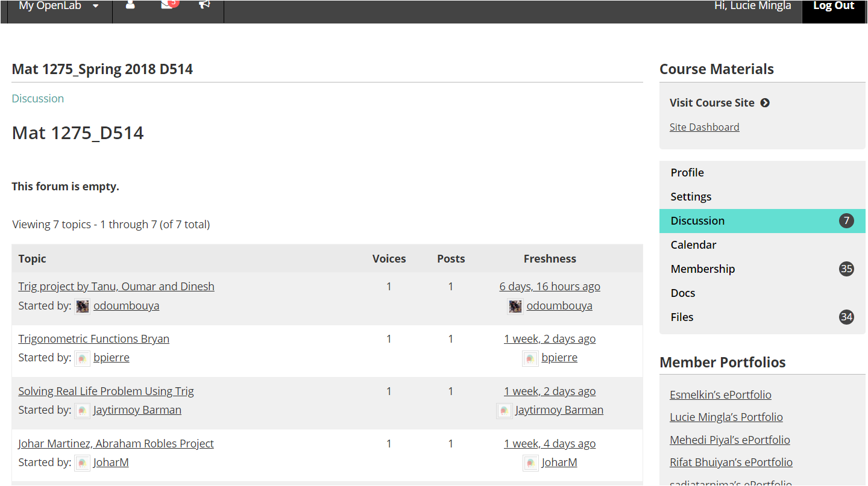

Slide 16
Using desmos.com online graphing calculator
Graphing live, observing and discovering
Have links ready for specific topic (example observing Riemann sums
Using activities that others have created
Customize your own activity
https://www.desmos.com/calculator
https://teacher.desmos.com/
https://student.desmos.com/
https://www.desmos.com/calculator/snxmbvfall

Slide 19
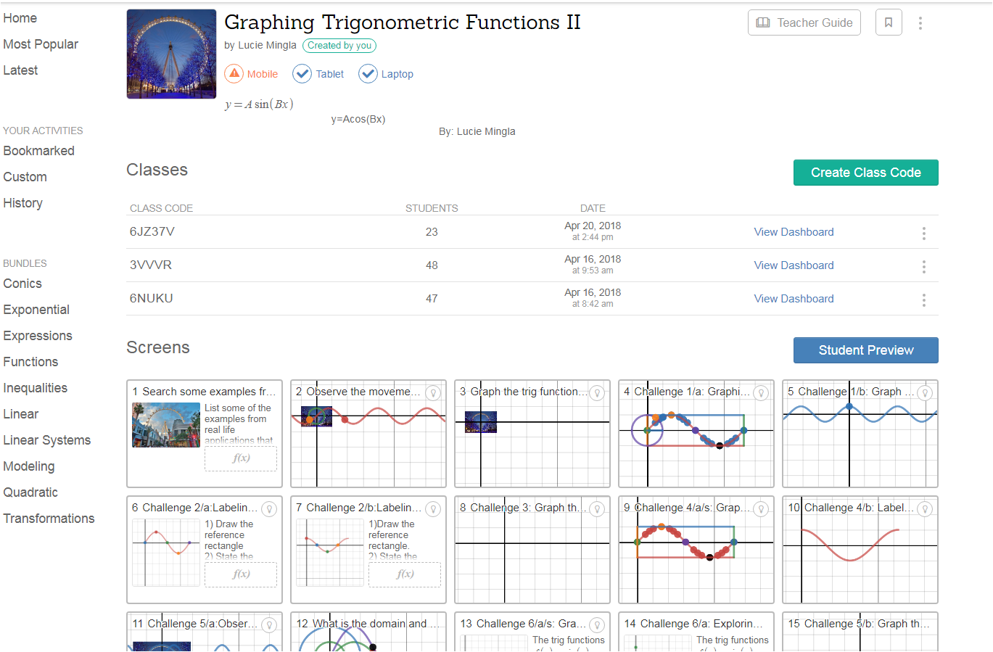

Slide 20
Key takeaways
The tool has a value when there is a meaningful relationship between the educational technology and pedagogy
We should start with curricula of the course, then identify strategies and the technologies that help achieving the goals
Open Educational Resources provide an opportunity for a richer teaching strategies and pedagogy, and integrating technology into courses with the goal of student centered philosophies of teaching
https://openlab.citytech.cuny.edu/groups/college-algebra-and-trigonometry/
https://teacher.desmos.com/custom

